Slide 1
Neural Networks
Aman Shakya

Slide 2
Neural Networks
Neural networks represent a brain metaphor for information processing. Neural computing refers to a pattern recognition methodology for machine learning. The resulting model from neural computing is often called an artificial neural network (ANN) or neural network (NN).
Due to their ability to learn from the data, their nonparametric nature (i.e., no rigid assumptions), and their ability to generalize, neural networks have been shown to be promising in many forecasting and business classification applications.

Slide 3
Basic Concepts of Neural Networks
The human brain is composed of special cells called nuerons.
Neural network elements
Nucleus
The central processing portion of a neuron
Soma
The main body of the neuron in which the cell nucleus is contained
Dendrite
The part of a biological neuron that provides inputs to the cell
Axon
An outgoing connection (i.e., terminal) from a biological neuron
Synapse
The connection (where the weights are) between processing elements in a neural network

Slide 4
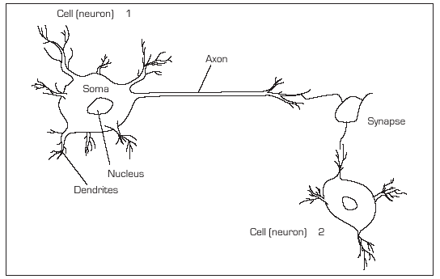
Structure of a Biological Neural Network

Slide 5
Artificial Neural Network
An ANN model emulates a biological neural network.
Neural concepts are usually implemented as software simulations of the massive parallel processes that involve processing elements (also called artificial neurons) interconnected in a network structure.
Connections between neurons have an associated weight.
Each neuron calculates a weighted sum of the incoming neuron values, transforms this input, and passes on its neural value as the input to subsequent neurons or external outputs.

Slide 6
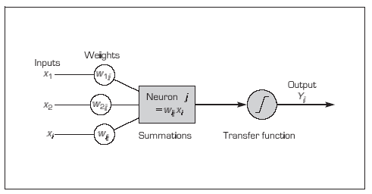
Processing Information in an Artificial Neuron

Slide 7
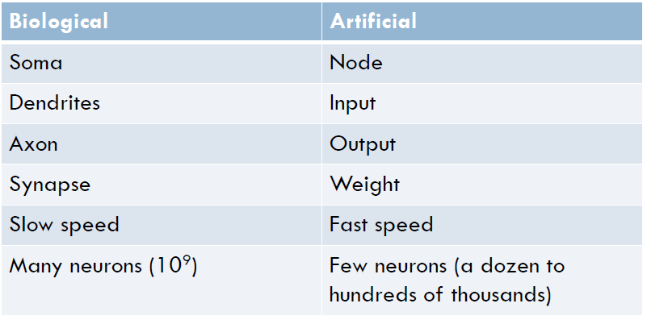
The Relationship Between Biological and Artificial Neural Networks

Slide 8
Multi-Layer Perceptron
One architecture of NNs is a multi-layer perceptron
The input layer introduces input values into the network ready for processing. No actual processing takes place at this stage.
The hidden layer(s) contains adjustable weights providing links between processors (neurons).Varying the weights will affect the accuracy of the decision-making performed by the system. The aim of human or computer training is to assign correct weights to each connections so that the NN makes correct decisions.
The output layer passes the output from the network to the outside world, normally via the explanatory interface.

Slide 9
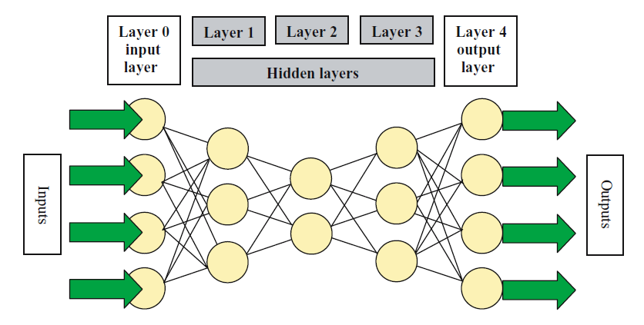
Multi-Layer Perceptron

Slide 10
The Back Propagation Algorithm
An error value is calculated for each node in the outer layer.
The weights feeding into each node, in this layer, are adjusted according to the error value for that node (in a similar way to the previous example).
The error, for each of the nodes, is then attributed to each of the nodes in the previous layer (on the basis of the strength of the connection). Thus the error is passed back through the network.
Steps 2 and 3 are repeated, i.e., the nodes in the preceding layer are adjusted, until the errors are propagated backwards through the entire network, finally reaching the input layer

Slide 11
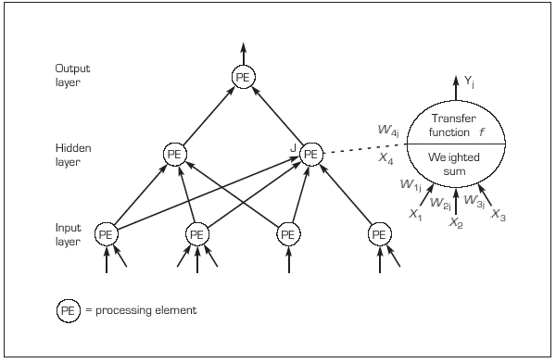
Neural Network with One Hidden Layer

Slide 12
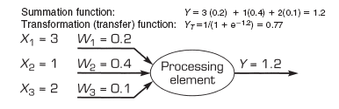
Example of ANN Functions

Slide 13
Learning in ANN
Supervised learning
Uses a set of inputs for which the desired outputs are known
Example: Back propagation algorithm
Unsupervised learning
Uses a set of inputs for which no desired output are known.
The system is self-organizing; that is, it organizes itself internally. A human must examine the final categories to assign meaning and determine the usefulness of the results.
Example: Self-organizing map

Slide 14
Characteristics of ANNs
Adaptive learning
Self-organization
Error tolerance
Real-time operation
Parallel information processing

Slide 15
Benefits and Limitations of Neural Networks
Benefits
Ability to tackle new kinds of problems
Robustness
Limitations
Performs less well at tasks humans tend to find difficult
Lack of explanation facilities
Requires large amounts of test data

Slide 16
Machine Learning Methods
Machine learning
The process by which a computer learns from experience (e.g., using programs that can learn from historical cases)

Slide 17
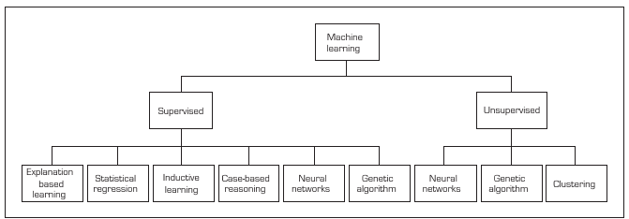
Machine Learning Methods

